Slide 1

DriverPass System Analysis
Bailey Goodwin
Notes:
[No speaker notes required for this slide.]

Slide 2

System Requirements
Functional Requirements:
The system shall have servers that run the application
The system shall keep track of user progress
Non-Functional Requirements:
The system will be secure
The system will run efficiently
Notes:
For any system it is important that we look at some of the requirements necessary to create the system, two of these are functional and non-functional requirements. Functional requirements are requirements that say what the system should do, and non-functional requirements are how well the system will use those resources. I focused on two requirements for both requirements, for function requirements I chose that the system shall have servers and that the system will keep track of user progress. The systems should run on servers so that it can stored information about and from the system which can then be connected to from many users. The system will track user progress so that it can be monitored to ensure that everything is working properly and no one is disrupting the system. For the two non-functional requirements, I chose the system will be secure and will run efficiently. It will run efficiently if it is run through servers and by tracking progress, we can keep the system secure so that user information is kept safe.

Slide 3
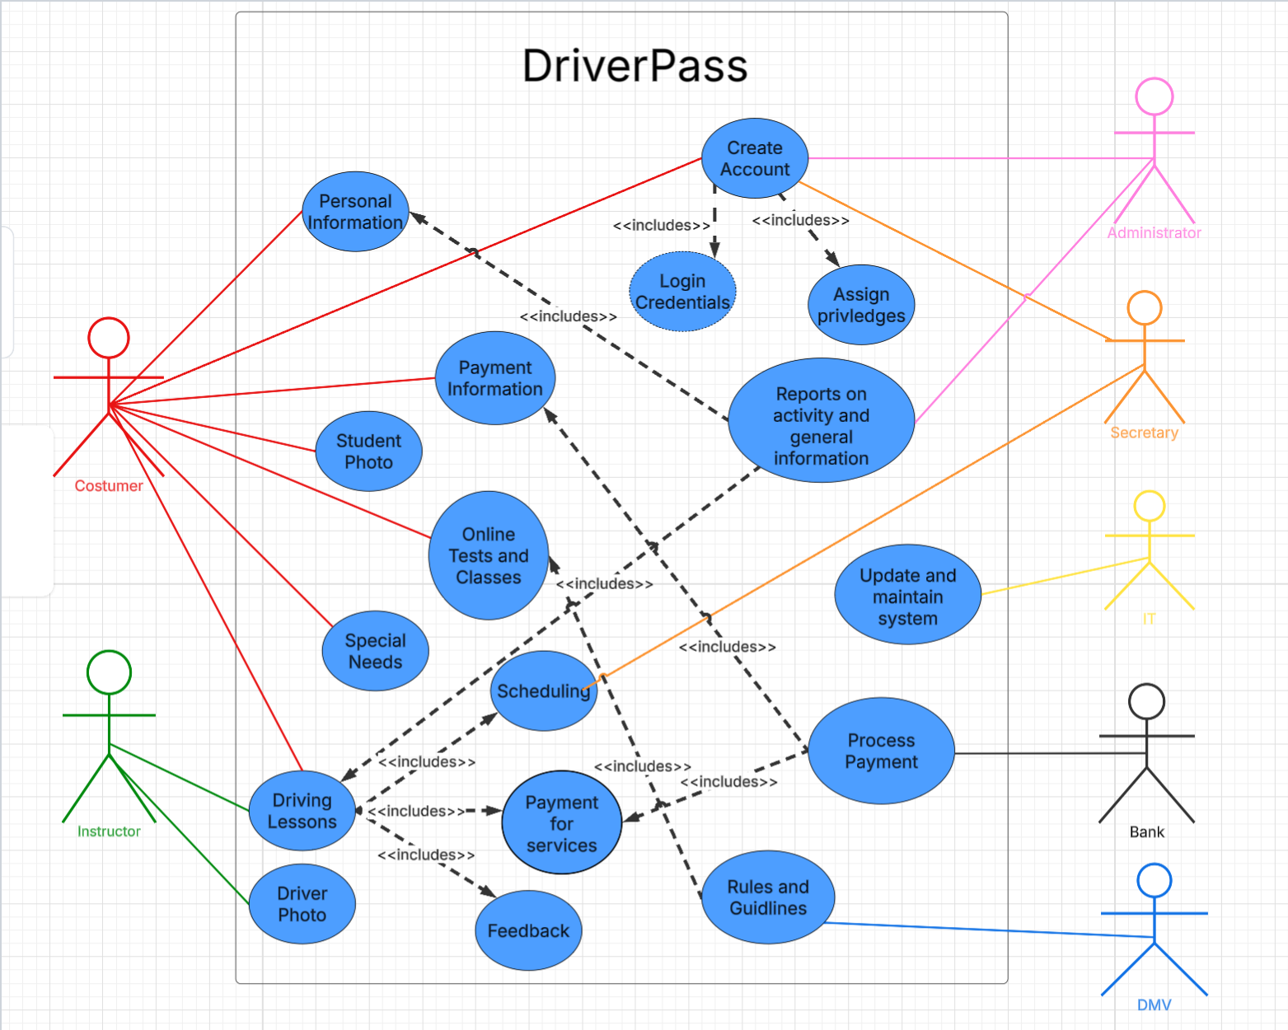
Use Case Diagram
Notes:
This diagram gives an overview of the DriverPass system that we are trying to create it shows many different users interacting with some of the things we would like our system to accomplish. Let’s look at how everything works, first we’ll look at the customer, they can create an account which would require the appropriate login information and would assign access privileges to the appropriate account. The customer can also insert payment information to pay for the driving lessons they sign up for, insert special needs they may have, upload a photo, take online tests & classes, and set up driving lessons. As apart of the driving lessons the customer will also need to schedule the lessons, pay for them, and look at feed back from the time they spent driving. Next, we have the driver, they can only upload a picture and accepts drives which they would receive money for doing. The payments of the driving packages would be processed by the bank which takes the money from the customer using their information and processes it, so the company and driver get paid. Administrators also have a role in setting up the driving appointments and get paid a they work for the company; they also must create accounts for themselves. The system takes information from the DMV so that the tests and classes that the customer uses have accurate information. The IT person is responsible for keeping the system updating along with implementing new features to make sure the application is up to date and the boss is the last person who can generate reports on user activity in the system as well as create an account that has full access to the system.

Slide 4
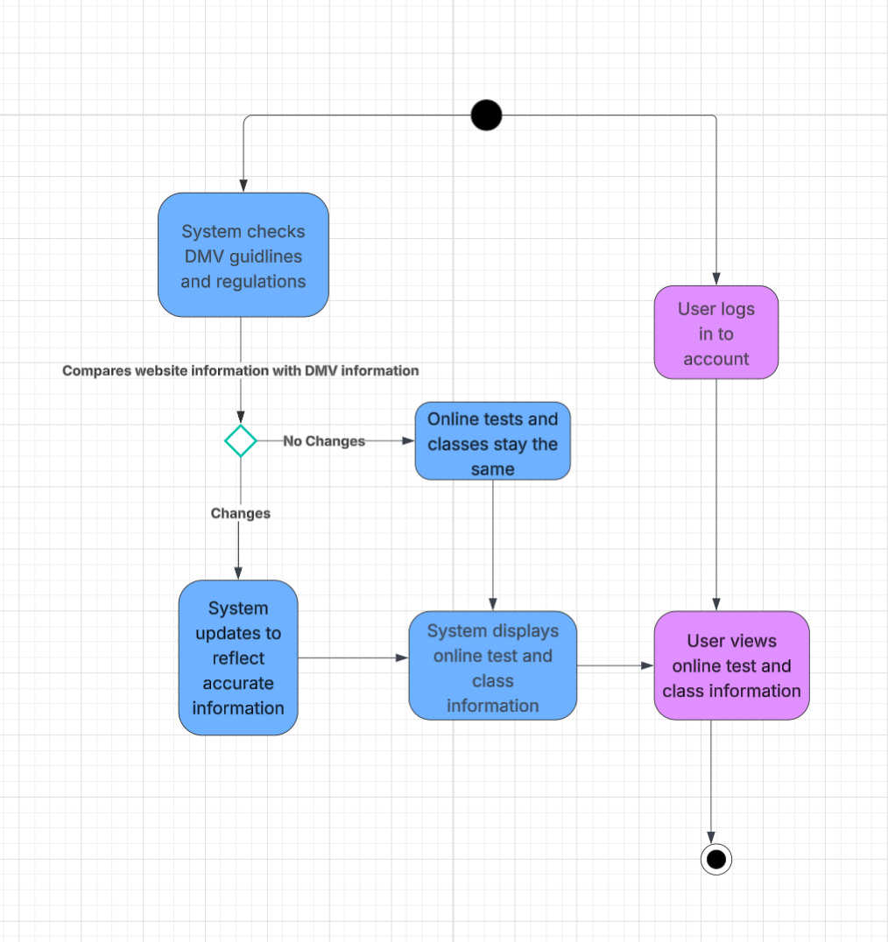
Activity Diagram
Notes:
This diagram is illustrating the process for the customer of our DriverPass system utilizing the online test, guidelines, and class information. At the start of the diagram an administrator checks to see if any changes have been made to the DMV rules or regulations. If no changes have been made, then the tests stay the same and the system displays the same information for test, classes, or guidelines. If the DMV did change the information, then the administrator changes that information and the system displays the updates tests, guidelines, and classes. To end, the customer logs into the system, they view and use the online tests, classes and guidelines as they see fit to help with their learning process.

Slide 5
Security
Strong passwords
Multi-factored Authentication
Account locking
Using cloud services
Encryption of data
Users are assigned different clearance
Unique account names
Notes:
Security is of the utmost important to our users, that’s why we want to cover a lot of security measures that we feel will help keep the system operational and secure. First, we will require users to have a strong password, that way they cannot be easily guessed or hacked. We will also implement a multiple checks for the user to enter the system, not only will they need a password, but they may also need to enter a code sent to their phone. If user fail these measure, we will implement a lock feature that will stop users from getting in for a period after so many attempts. We will be using cloud computing on top of this which will offer services that can with a variety of security features, we will be sure to encrypt all data, so it is safe and secure as well. Each account will have a unique name so that it can only be one specific person for each account, from there we can restrict access to these accounts and have access privileges assigned to each one depending what type of user they are. We believe that these will be the best security measures for the system.

Slide 6
System Limitations
Will have to adhere to the budget
May be limited due to time constraints
Users will need access to the internet
Users will need a device to use the system
Needs to be current with DMV information
Users will need to be in the US
Notes:
Lastly, we are going to look at the limitations for the system for are the restraints that it has which could negative impact the final product or usability. The first is that we must stay on budget for the creation of the system, this may mean the system will not have all of the features the client wanted. Another factor that could limit the system are the time constraints that could come up in the development process which could require us to release a premature project. The next limitations are that the users will need internet to access our system, and they will need a device the uses internet and can run the system. Our last two limitations are that the website needs to follow current DMV guidelines/rules and because this system is based off the DMV are users will need to be in the United States to benefit from using this system which will lower our demographic.

